Slide 1


Making the websites accessible - to ALL
Anuradha Kumari
Frontend Consultant, Passionate People
India

Slide 2
Topics we will cover:
What is accessibility?
State of web accessibility
Tips to create accessible websites

Slide 3
Accessibility

Slide 4
Accessibility
A 11 Y

Slide 5
Making resources and services usable by everyone

Slide 6
Why should we care?

Slide 7
15% of world’s population lives with some form of disability
WHO

Slide 8

Multiple Types of disabilities:
Visual
Auditory
Motor
Cognitive

Slide 9
Multiple Ways to access Web
Keyboard
Screen Readers
Switch
Magnifiers

Slide 10
State of web a11y

Slide 11
WebAIM - project 1 million

Slide 12
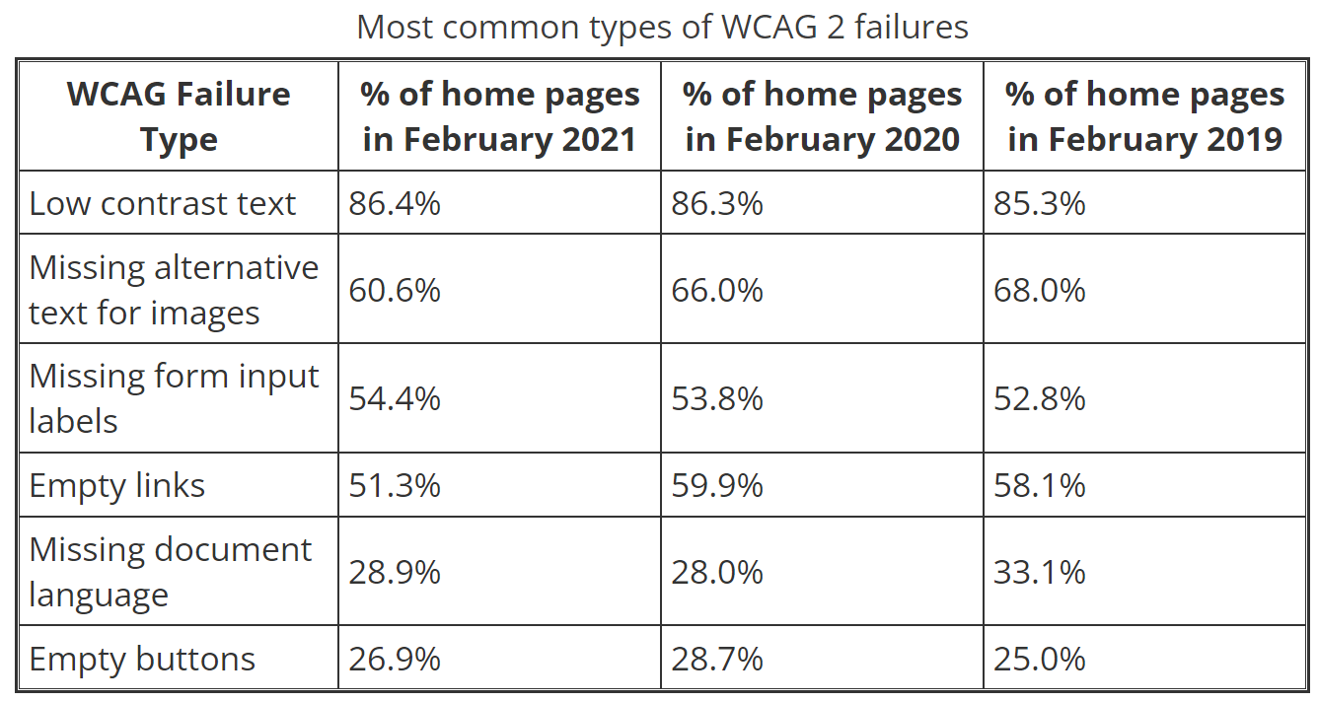

Slide 13
We are making the web inaccessible by not following the standard coding guidelines

Slide 14
How to fix these issues?

Slide 15
Low Contrast text - 86.4% errors
Contrast - measure of perceived difference in perceived luminance
Tool - Contrast checker

Slide 16
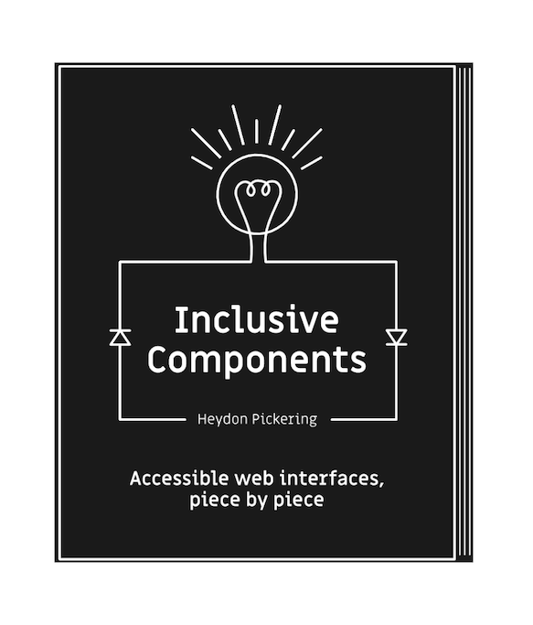
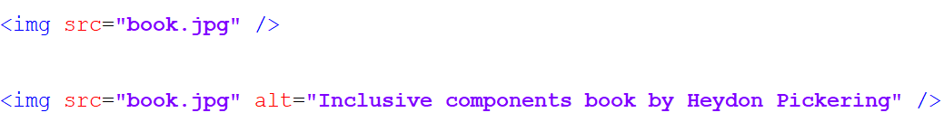
Text alternative - 60.6% errors
Graphics, missing label
As read by screen readers

Slide 17
Book name
Author name
Graphics, Inclusive components book by Heydon Pickering
As read by screen readers

Slide 18
Always add alt for images
<img alt=”describe the image here if image is informative” src=”” />
if image is decorative
<img alt=”” src=”” />

Slide 19
Form Input labels - 54.4% errors
Email address
Required
Email address
Password (min 8 chars)
Required
Password
SIGN UP

Slide 20
Always label inputs
<label>
Email address:
<input type=”email” placeholder=”Email address” />
</label>

Slide 21
Always label inputs
<label for=”email”>
Email address:
</label>
<input type=”email” name=”email” placeholder=”Email address” />

Slide 22
Visually hidden labels - HTML
<label for=”email” class=”sr-only”>
Email address:
</label>
<input type=”email” name=”email” placeholder=”Email address” />

Slide 23
Visually hidden labels - CSS
.sr-only {
clip: rect(1px, 1px, 1px, 1px);
-webkit-clip-path: inset(50%);
clip-path: inset(50%);
height: 1px; width: 1px;
overflow: hidden;
position: absolute;
white-space: nowrap;
}

Slide 24

Empty links - 51.3 % errors
<a href="https://twitter.com/miracle_404">
<i class="twitter-icon"></i>
</a>

Slide 25
Provide text for image only links/buttons
<a href="https://twitter.com/miracle_404">
<i aria-hidden=”true” class="twitter-icon"></i>
<span class=”sr-only”> twitter </span>
</a>

Slide 26
Provide text for image only links/buttons
<a href="https://twitter.com/miracle_404"
aria-label=”twitter”>
<i aria-hidden=”true” class="twitter-icon"></i>
</a>

Slide 27
Document Language - 28.9 % errors
<element lang="language_code">
<html lang=”en”> … </html>
<section lang=”es”> … </section>

Slide 28
Helpful Tools and extensions

Slide 29
Chrome DevTools features
Lighthouse - accessibility audit
Accessibility pane

Slide 30
Browser extensions
Wave
Axe devTools

Slide 31
Action Items

Slide 32
Pass on the learnings,
Spread the awareness

Slide 33
Let’s make the web more accessible and inclusive for everyone

Slide 34
Resources
WAI-ARIA Authoring practices
WebAIM
Explore web accessibility

Slide 35
Thank you!

